Slide 1
Social Network Analysis
Social Network Introduction
Statistics and Probability Theory
Models of Social Network Generation
Networks in Biological System
Mining on Social Network
Summary
Data Mining: Concepts and Techniques

Slide 2
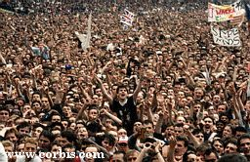
Society
Nodes: individuals
Links: social relationship (family/work/friendship/etc.)
S. Milgram (1967)
John Guare
Six Degrees of Separation
Social networks: Many individuals with diverse social interactions between them.
Data Mining: Concepts and Techniques

Slide 3
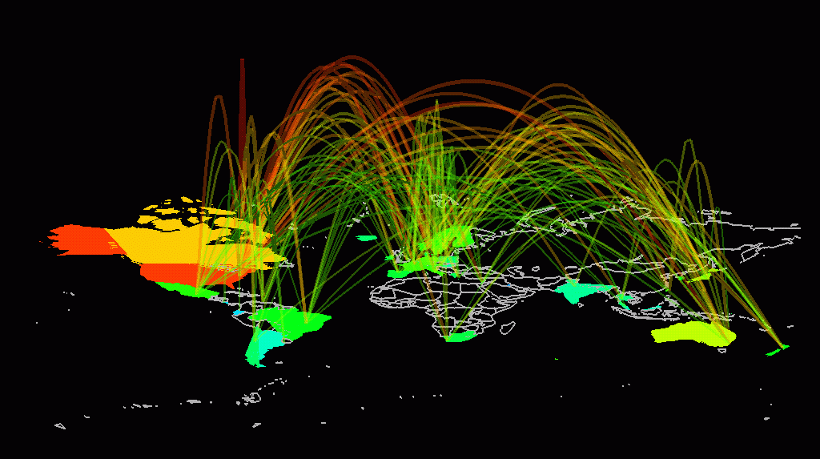
Communication networks
The Earth is developing an electronic nervous system, a network with diverse nodes and links are
-computers
-routers
-satellites
-phone lines
-TV cables
-EM waves
Communication networks: Many non-identical components with diverse connections between them.
Data Mining: Concepts and Techniques

Slide 4
“Natural” Networks and Universality
Consider many kinds of networks:
  social, technological, business, economic, content,…
These networks tend to share certain informal properties:
  large scale; continual growth
  distributed, organic growth: vertices “decide” who to link to
  interaction restricted to links
  mixture of local and long-distance connections
  abstract notions of distance: geographical, content, social,…
Do natural networks share more quantitative universals?
What would these “universals” be?
How can we make them precise and measure them?
How can we explain their universality?
This is the domain of social network theory
Sometimes also referred to as link analysis
Data Mining: Concepts and Techniques

Slide 5
Some Interesting Quantities
Connected components:
  how many, and how large?
Network diameter:
  maximum (worst-case) or average?
  exclude infinite distances? (disconnected components)
  the small-world phenomenon
Clustering:
  to what extent that links tend to cluster “locally”?
  what is the balance between local and long-distance connections?
  what roles do the two types of links play?
Degree distribution:
  what is the typical degree in the network?
  what is the overall distribution?
Data Mining: Concepts and Techniques

Slide 6
A “Canonical” Natural Network has…
Few connected components:
  often only 1 or a small number, indep. of network size
Small diameter:
  often a constant independent of network size (like 6)
  or perhaps growing only logarithmically with network size or even shrink?
  typically exclude infinite distances
A high degree of clustering:
  considerably more so than for a random network
  in tension with small diameter
A heavy-tailed degree distribution:
  a small but reliable number of high-degree vertices
  often of power law form
Data Mining: Concepts and Techniques
Notes:
MIGHT GIVE REAL EXAMPLES HERE? FROM WATTS?

Slide 7
Social Network Analysis
Social Network Introduction
Statistics and Probability Theory
Models of Social Network Generation
Networks in Biological System
Mining on Social Network
Summary
Data Mining: Concepts and Techniques

Slide 8
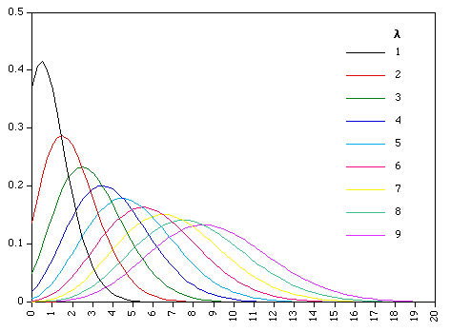
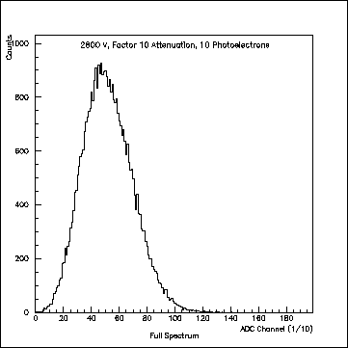
The Poisson Distribution
single photoelectron distribution
Data Mining: Concepts and Techniques

Slide 9
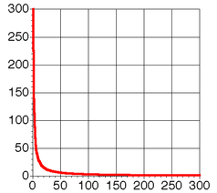
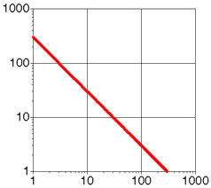
Zipf’s Law
The same data plotted on linear and logarithmic scales. Both plots show a Zipf distribution with 300 datapoints
Linear scales on both axes
Logarithmic scales on both axes
Data Mining: Concepts and Techniques

Slide 10
Social Network Analysis
Social Network Introduction
Statistics and Probability Theory
Models of Social Network Generation
Networks in Biological System
Mining on Social Network
Summary
Data Mining: Concepts and Techniques

Slide 11
Some Models of Network Generation
Random graphs (Erdös-Rényi models):
  gives few components and small diameter
  does not give high clustering and heavy-tailed degree distributions
  is the mathematically most well-studied and understood model
Watts-Strogatz models:
  give few components, small diameter and high clustering
  does not give heavy-tailed degree distributions
Scale-free Networks:
  gives few components, small diameter and heavy-tailed distribution
  does not give high clustering
Hierarchical networks:
  few components, small diameter, high clustering, heavy-tailed
Affiliation networks:
  models group-actor formation
Data Mining: Concepts and Techniques

Slide 12
Models of Social Network Generation
Random Graphs (Erdös-Rényi models)
Watts-Strogatz models
Scale-free Networks
Data Mining: Concepts and Techniques

Slide 13
The Erdös-Rényi (ER) Model
(Random Graphs)
All edges are equally probable and appear independently
NW size N > 1 and probability p: distribution G(N,p)
  each edge (u,v) chosen to appear with probability p
  N(N-1)/2 trials of a biased coin flip
The usual regime of interest is when p ~ 1/N, N is large
  e.g. p = 1/2N, p = 1/N, p = 2/N, p=10/N, p = log(N)/N, etc.
  in expectation, each vertex will have a “small” number of neighbors
  will then examine what happens when N → infinity
  can thus study properties of large networks with bounded degree
Degree distribution of a typical G drawn from G(N,p):
  draw G according to G(N,p); look at a random vertex u in G
  what is Pr[deg(u) = k] for any fixed k?
  Poisson distribution with mean l = p(N-1) ~ pN
  Sharply concentrated; not heavy-tailed
Especially easy to generate NWs from G(N,p)
Data Mining: Concepts and Techniques

Slide 14

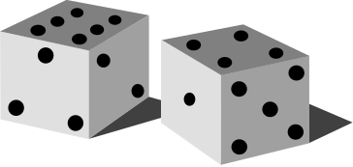
Erdös-Rényi Model (1960)
Connect with probability p
Pál Erdös (1913-1996)
p=1/6 N=10 ⟨k⟩~1.5
Poisson distribution
- Democratic
- Random
Data Mining: Concepts and Techniques

Slide 15
The Clustering Coefficient of a Network
Let nbr(u) denote the set of neighbors of u in a graph
  all vertices v such that the edge (u,v) is in the graph
The clustering coefficient of u:
  let k = |nbr(u)| (i.e., number of neighbors of u)
  choose(k,2): max possible # of edges between vertices in nbr(u)
  c(u) = (actual # of edges between vertices in nbr(u))/choose(k,2)
  0 <= c(u) <= 1; measure of cliquishness of u’s neighborhood
Clustering coefficient of a graph:
  average of c(u) over all vertices u
k = 4
choose(k,2) = 6
c(u) = 4/6 = 0.666…
Data Mining: Concepts and Techniques

Slide 16
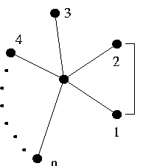
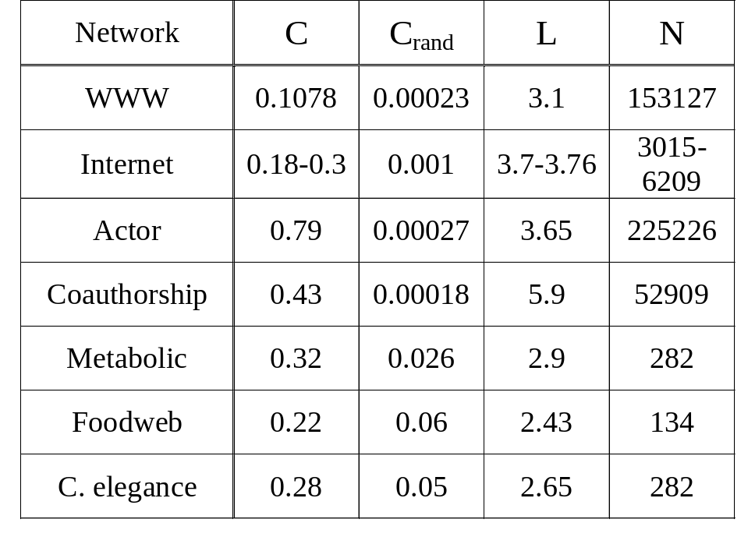
The Clustering Coefficient of a Network
Clustering: My friends will likely know each other!
Probability to be connected C » p
# of links between 1,2,…n neighbors
C =
n(n-1)/2
Networks are clustered [large C(p)] but have a small characteristic path length [small L(p)].
Data Mining: Concepts and Techniques

Slide 17
Small Worlds and Occam’s Razor
For small α, should generate large clustering coefficients
  we “programmed” the model to do so
  Watts claims that proving precise statements is hard…
But we do not want a new model for every little property
  Erdos-Renyi → small diameter
  α-model → high clustering coefficient
In the interests of Occam’s Razor, we would like to find
  a single, simple model of network generation…
  … that simultaneously captures many properties
Watt’s small world: small diameter and high clustering
Data Mining: Concepts and Techniques

Slide 18
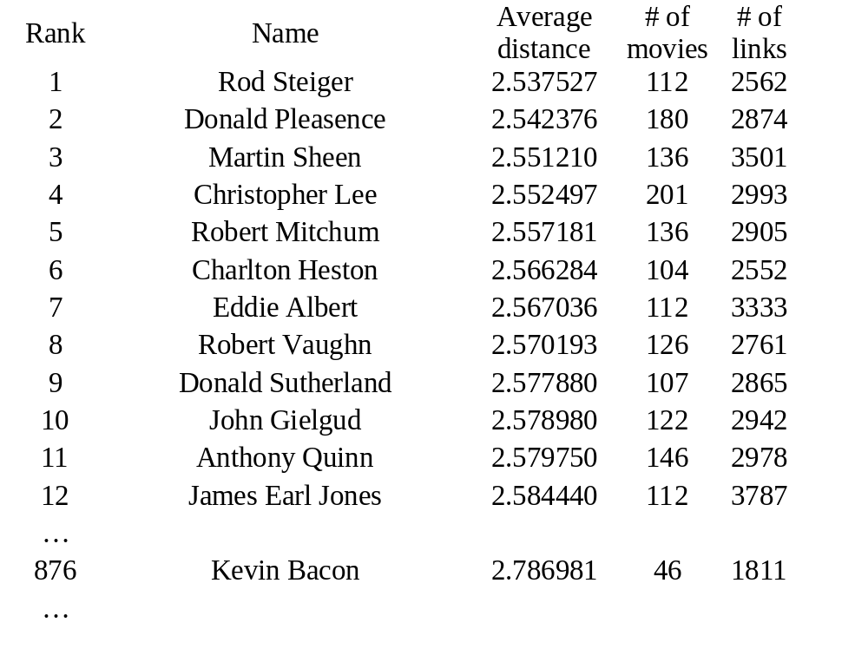
Case 1: Kevin Bacon Graph
Vertices: actors and actresses
Edge between u and v if they appeared in a film together
Kevin Bacon
No. of movies : 46 No. of actors : 1811 Average separation: 2.79
Is Kevin Bacon the most connected actor?
NO!
876 Kevin Bacon 2.786981 46 1811
Data Mining: Concepts and Techniques

Slide 19

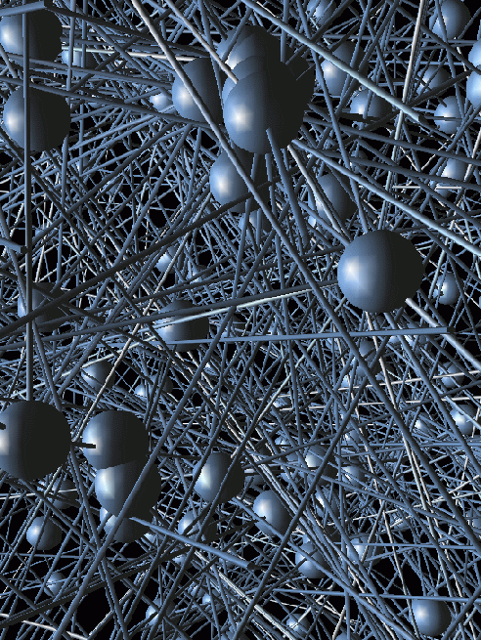




Bacon-map
#1
Rod Steiger
#876
Kevin Bacon
Donald Pleasence
#2
#3
Martin Sheen
Data Mining: Concepts and Techniques

Slide 20
Models of Social Network Generation
Random Graphs (Erdös-Rényi models)
Watts-Strogatz models
Scale-free Networks
Data Mining: Concepts and Techniques

Slide 21

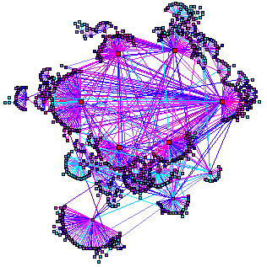
World Wide Web
Nodes: WWW documents Links: URL links
800 million documents (S. Lawrence, 1999)
ROBOT: collects all URL’s found in a document and follows them recursively
R. Albert, H. Jeong, A-L Barabasi, Nature, 401 130 (1999)
Data Mining: Concepts and Techniques

Slide 22
World Wide Web
Expected Result
Real Result
γ_{out}= 2.45
γ _{in} = 2.1
⟨k⟩ ~ 6
P(k=500) ~ 10⁻⁹⁹
P_{out}(k) ~ k^{-γout}
P_{in}(k) ~ k^{- γin}
N_{WWW} ~ 10⁹
⇒ N(k=500)~10⁻⁹⁰
N_{WWW} ~ 10⁹
⇒ N(k=500) ~ 10³
P(k=500) ~ 10⁻⁶
J. Kleinberg, et. al, Proceedings of the ICCC (1999)
Data Mining: Concepts and Techniques

Slide 23
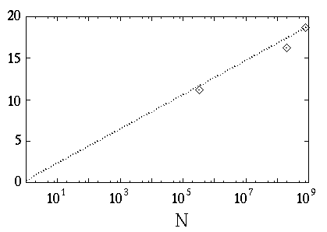
World Wide Web
3
l₁₅=2 [1→2→5]
l₁₇=4 [1→3→4→6 → 7]
… < l > = ??
6
1
4
7
2
5
• Finite size scaling: create a network with N nodes with P_{in}(k) and P_{out}(k)
< l > = 0.35 + 2.06 log(N)
19 degrees of separation R. Albert et al Nature (99)
based on 800 million webpages [S. Lawrence et al Nature (99)]
nd.edu
< l >
IBM
A. Broder et al WWW9 (00)
Data Mining: Concepts and Techniques

Slide 24
Scale-free Networks
The number of nodes (N) is not fixed
  Networks continuously expand by additional new nodes
    WWW: addition of new nodes
    Citation: publication of new papers
The attachment is not uniform
  A node is linked with higher probability to a node that already has a large number of links
    WWW: new documents link to well known sites (CNN, Yahoo, Google)
    Citation: Well cited papers are more likely to be cited again
Data Mining: Concepts and Techniques

Slide 25
Scale-Free Networks
Start with (say) two vertices connected by an edge
For i = 3 to N:
  for each 1 <= j < i, d(j) = degree of vertex j so far
  let Z = S d(j) (sum of all degrees so far)
  add new vertex i with k edges back to {1, …, i-1}:
    i is connected back to j with probability d(j)/Z
Vertices j with high degree are likely to get more links!
“Rich get richer”
Natural model for many processes:
  hyperlinks on the web
  new business and social contacts
  transportation networks
Generates a power law distribution of degrees
  exponent depends on value of k
Data Mining: Concepts and Techniques

Slide 26
Scale-Free Networks
Preferential attachment explains
  heavy-tailed degree distributions
  small diameter (~log(N), via “hubs”)
Will not generate high clustering coefficient
  no bias towards local connectivity, but towards hubs
Data Mining: Concepts and Techniques

Slide 27
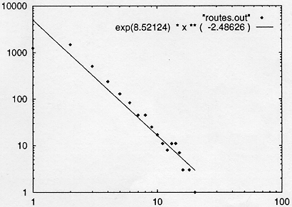
Case1: Internet Backbone
Nodes: computers, routers Links: physical lines
(Faloutsos, Faloutsos and Faloutsos, 1999)
Data Mining: Concepts and Techniques

Slide 28
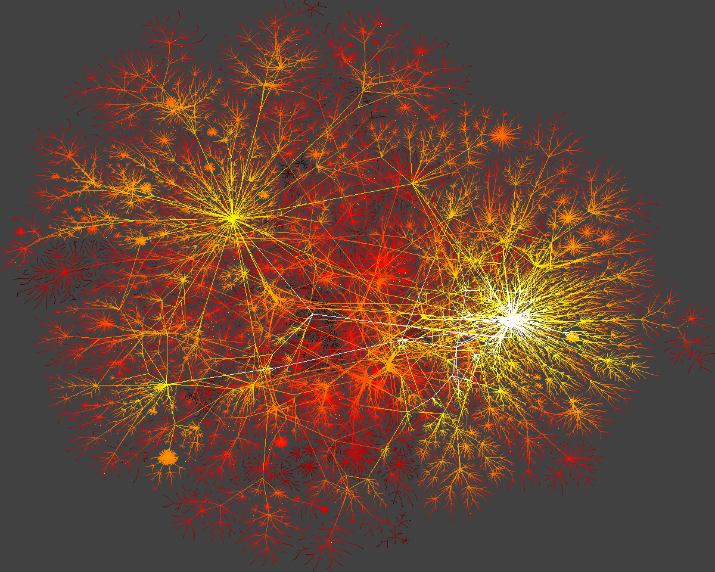
Internet-Map
Data Mining: Concepts and Techniques

Slide 29
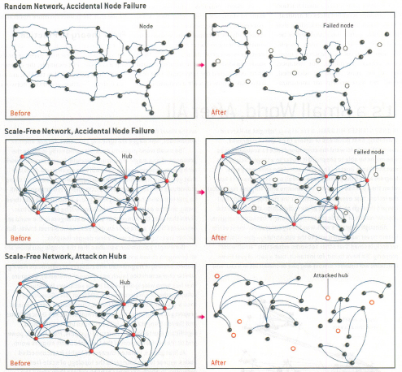
Robustness of
Random vs. Scale-Free Networks
The accidental failure of a number of nodes in a random network can fracture the system into non-communicating islands.
Scale-free networks are more robust in the face of such failures.
Scale-free networks are highly vulnerable to a coordinated attack against their hubs.
Data Mining: Concepts and Techniques

Slide 30
Social Network Analysis
Social Network Introduction
Statistics and Probability Theory
Models of Social Network Generation
Networks in Biological System
Mining on Social Network
Summary
Data Mining: Concepts and Techniques

Slide 31
Information on the Social Network
Heterogeneous, multi-relational data represented as a graph or network
  Nodes are objects
    May have different kinds of objects
    Objects have attributes
    Objects may have labels or classes
  Edges are links
    May have different kinds of links
    Links may have attributes
    Links may be directed, are not required to be binary
Links represent relationships and interactions between objects - rich content for mining
Data Mining: Concepts and Techniques

Slide 32
What is New for Link Mining Here
Traditional machine learning and data mining approaches assume:
  A random sample of homogeneous objects from single relation
Real world data sets:
  Multi-relational, heterogeneous and semi-structured
Link Mining
  Newly emerging research area at the intersection of research in social network and link analysis, hypertext and web mining, graph mining, relational learning and inductive logic programming
Data Mining: Concepts and Techniques

Slide 33
A Taxonomy of Common Link Mining Tasks
Object-Related Tasks
  Link-based object ranking
  Link-based object classification
  Object clustering (group detection)
  Object identification (entity resolution)
Link-Related Tasks
  Link prediction
Graph-Related Tasks
  Subgraph discovery
  Graph classification
  Generative model for graphs
Data Mining: Concepts and Techniques

Slide 34
What Is a Link in Link Mining?
Link: relationship among data
Two kinds of linked networks
  homogeneous vs. heterogeneous
Homogeneous networks
  Single object type and single link type
  Single model social networks (e.g., friends)
  WWW: a collection of linked Web pages
Heterogeneous networks
  Multiple object and link types
  Medical network: patients, doctors, disease, contacts, treatments
  Bibliographic network: publications, authors, venues
Data Mining: Concepts and Techniques

Slide 35
Link-Based Object Ranking (LBR)
LBR: Exploit the link structure of a graph to order or prioritize the set of objects within the graph
  Focused on graphs with single object type and single link type
This is a primary focus of link analysis community
Web information analysis
  PageRank and Hits are typical LBR approaches
In social network analysis (SNA), LBR is a core analysis task
  Objective: rank individuals in terms of “centrality”
  Degree centrality vs. eigen vector/power centrality
  Rank objects relative to one or more relevant objects in the graph vs. ranks object over time in dynamic graphs
Data Mining: Concepts and Techniques

Slide 36
PageRank: Capturing Page Popularity (Brin & Page’98)
Intuitions
  Links are like citations in literature
  A page that is cited often can be expected to be more useful in general
PageRank is essentially “citation counting”, but improves over simple counting
  Consider “indirect citations” (being cited by a highly cited paper counts a lot…)
  Smoothing of citations (every page is assumed to have a non-zero citation count)
PageRank can also be interpreted as random surfing (thus capturing popularity)
Data Mining: Concepts and Techniques

Slide 37
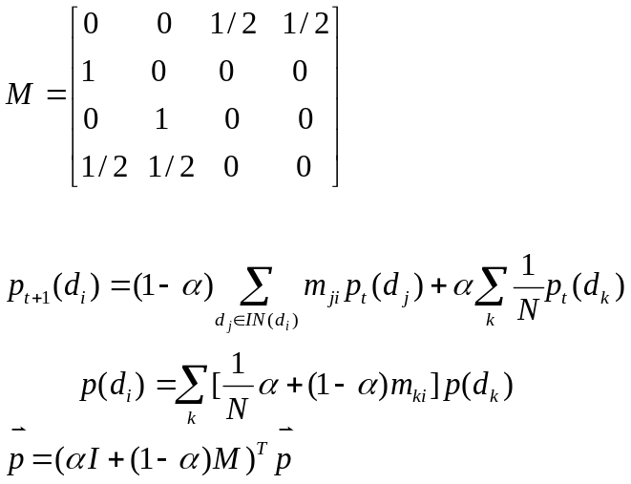
The PageRank Algorithm (Brin & Page’98)
Random surfing model:
At any page,
With prob. α, randomly jumping to a page
With prob. (1 – α), randomly picking a link to follow
d₁
“Transition matrix”
Same as
α/N (why?)
d₃
d₂
d₄
Stationary (“stable”) distribution, so we ignore time
I_{ij} = 1/N
Initial value p(d)=1/N
Iterate until converge
Essentially an eigenvector problem….
Data Mining: Concepts and Techniques

Slide 38
HITS: Capturing Authorities & Hubs (Kleinberg’98)
Intuitions
  Pages that are widely cited are good authorities
  Pages that cite many other pages are good hubs
The key idea of HITS
  Good authorities are cited by good hubs
  Good hubs point to good authorities
  Iterative reinforcement …
Data Mining: Concepts and Techniques

Slide 39
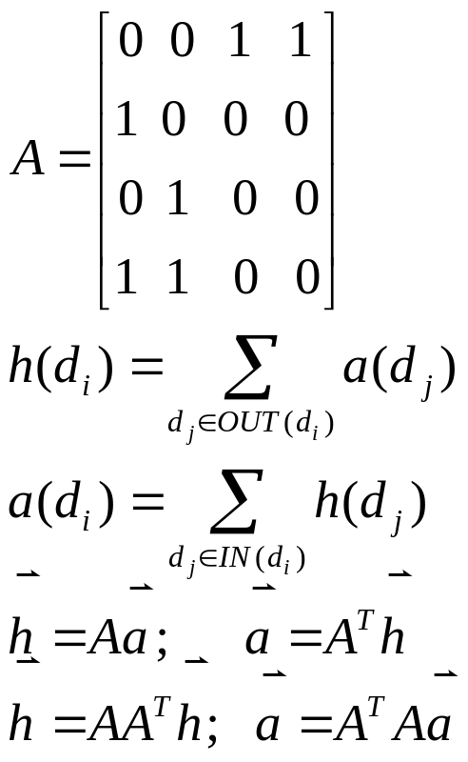
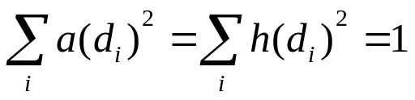
The HITS Algorithm (Kleinberg 98)
d₁
“Adjacency matrix”
d₃
Initial values: a=h=1
d₂
d₄
Iterate
Normalize:
Again eigenvector problems…
Data Mining: Concepts and Techniques

Slide 40
Block-level Link Analysis (Cai et al. 04)
Most of the existing link analysis algorithms, e.g. PageRank and HITS, treat a web page as a single node in the web graph
However, in most cases, a web page contains multiple semantics and hence it might not be considered as an atomic and homogeneous node
Web page is partitioned into blocks using the vision-based page segmentation algorithm
extract page-to-block, block-to-page relationships
Block-level PageRank and Block-level HITS
Data Mining: Concepts and Techniques

Slide 41
Link-Based Object Classification (LBC)
Predicting the category of an object based on its attributes, its links and the attributes of linked objects
Web: Predict the category of a web page, based on words that occur on the page, links between pages, anchor text, html tags, etc.
Citation: Predict the topic of a paper, based on word occurrence, citations, co-citations
Epidemics: Predict disease type based on characteristics of the patients infected by the disease
Communication: Predict whether a communication contact is by email, phone call or mail
Data Mining: Concepts and Techniques

Slide 42
Challenges in Link-Based Classification
Labels of related objects tend to be correlated
Collective classification: Explore such correlations and jointly infer the categorical values associated with the objects in the graph
Ex: Classify related news items in Reuter data sets (Chak’98)
  Simply incorp. words from neighboring documents: not helpful
Multi-relational classification is another solution for link-based classification
Data Mining: Concepts and Techniques

Slide 43
Group Detection
Cluster the nodes in the graph into groups that share common characteristics
  Web: identifying communities
  Citation: identifying research communities
Methods
  Hierarchical clustering
  Blockmodeling of SNA
  Spectral graph partitioning
  Stochastic blockmodeling
  Multi-relational clustering
Data Mining: Concepts and Techniques

Slide 44
Entity Resolution
Predicting when two objects are the same, based on their attributes and their links
Also known as: deduplication, reference reconciliation, co-reference resolution, object consolidation
Applications
  Web: predict when two sites are mirrors of each other
  Citation: predicting when two citations are referring to the same paper
  Epidemics: predicting when two disease strains are the same
  Biology: learning when two names refer to the same protein
Data Mining: Concepts and Techniques

Slide 45
Entity Resolution Methods
Earlier viewed as pair-wise resolution problem: resolved based on the similarity of their attributes
Importance at considering links
  Coauthor links in bib data, hierarchical links between spatial references, co-occurrence links between name references in documents
Use of links in resolution
  Collective entity resolution: one resolution decision affects another if they are linked
    Propagating evidence over links in a depen. graph
  Probabilistic models interact with different entity recognition decisions
Data Mining: Concepts and Techniques

Slide 46
Link Prediction
Predict whether a link exists between two entities, based on attributes and other observed links
Applications
  Web: predict if there will be a link between two pages
  Citation: predicting if a paper will cite another paper
  Epidemics: predicting who a patient’s contacts are
Methods
  Often viewed as a binary classification problem
  Local conditional probability model, based on structural and attribute features
  Difficulty: sparseness of existing links
  Collective prediction, e.g., Markov random field model
Data Mining: Concepts and Techniques

Slide 47
Link Cardinality Estimation
Predicting the number of links to an object
  Web: predict the authority of a page based on the number of in-links; identifying hubs based on the number of out-links
  Citation: predicting the impact of a paper based on the number of citations
  Epidemics: predicting the number of people that will be infected based on the infectiousness of a disease
Predicting the number of objects reached along a path from an object
  Web: predicting number of pages retrieved by crawling a site
  Citation: predicting the number of citations of a particular author in a specific journal
Data Mining: Concepts and Techniques

Slide 48
Subgraph Discovery
Find characteristic subgraphs
  Focus of graph-based data mining
Applications
  Biology: protein structure discovery
  Communications: legitimate vs. illegitimate groups
  Chemistry: chemical substructure discovery
Methods
  Subgraph pattern mining
Graph classification
  Classification based on subgraph pattern analysis
Data Mining: Concepts and Techniques

Slide 49
Metadata Mining
Schema mapping, schema discovery, schema reformulation
cite – matching between two bibliographic sources
web - discovering schema from unstructured or semi-structured data
bio – mapping between two medical ontologies
Data Mining: Concepts and Techniques

Slide 50
Link Mining Challenges
Logical vs. statistical dependencies
Feature construction
Instances vs. classes
Collective classification
Collective consolidation
Effective use of labeled & unlabeled data
Link prediction
Closed vs. open world
Challenges common to any link-based statistical model (Bayesian Logic Programs, Conditional Random Fields, Probabilistic Relational Models, Relational Markov Networks, Relational Probability Trees, Stochastic Logic Programming to name a few)
Data Mining: Concepts and Techniques

Slide 51
Logical vs. Statistical Dependence
Coherently handling two types of dependence structures:
  Link structure - the logical relationships between objects
  Probabilistic dependence - statistical relationships between attributes
Challenge: statistical models that support rich logical relationships
Model search complicated by the fact that attributes can depend on arbitrarily linked attributes -- issue: how to search this huge space
Data Mining: Concepts and Techniques

Slide 52
Feature Construction
In many cases, objects are linked to a set of objects. To construct a single feature from this set of objects, we may either use:
  Aggregation
  Selection
Data Mining: Concepts and Techniques

Slide 53
Individuals vs. Classes
Does model refer
  explicitly to individuals
  classes or generic categories of individuals
On one hand, we’d like to be able to model that a connection to a particular individual may be highly predictive
On the other hand, we’d like our models to generalize to new situations, with different individuals
Data Mining: Concepts and Techniques

Slide 54
Collective Classification
Using a link-based statistical model for classification
Inference using learned model is complicated by the fact that there is correlation between the object labels
Data Mining: Concepts and Techniques

Slide 55
Collective Consolidation
Using a link-based statistical model for object consolidation
Consolidation decisions should not be made independently
Data Mining: Concepts and Techniques

Slide 56
Labeled & Unlabeled Data
In link-based domains, unlabeled data provide three sources of information:
  Helps us infer object attribute distribution
  Links between unlabeled data allow us to make use of attributes of linked objects
  Links between labeled data and unlabeled data (training data and test data) help us make more accurate inferences
Data Mining: Concepts and Techniques

Slide 57
Link Prior Probability
The prior probability of any particular link is typically extraordinarily low
For medium-sized data sets, we have had success with building explicit models of link existence
It may be more effective to model links at higher level--required for large data sets
Data Mining: Concepts and Techniques

Slide 58
Closed World vs. Open World
The majority of SRL approaches make a closed world assumption, which assumes that we know all the potential entities in the domain
In many cases, this is unrealistic
Work by Milch, Marti, Russell on BLOG
Data Mining: Concepts and Techniques

Slide 59
Social Network Analysis
Social Network Introduction
Statistics and Probability Theory
Models of Social Network Generation
Networks in Biological System
Mining on Social Network
Summary
Data Mining: Concepts and Techniques

Slide 60
Ref: Mining on Social Networks
D. Liben-Nowell and J. Kleinberg. The Link Prediction Problem for Social Networks. CIKM’03
P. Domingos and M. Richardson, Mining the Network Value of Customers. KDD’01
M. Richardson and P. Domingos, Mining Knowledge-Sharing Sites for Viral Marketing. KDD’02
D. Kempe, J. Kleinberg, and E. Tardos, Maximizing the Spread of Influence through a Social Network. KDD’03.
P. Domingos, Mining Social Networks for Viral Marketing. IEEE Intelligent Systems, 20(1), 80-82, 2005.
S. Brin and L. Page, The anatomy of a large scale hypertextual Web search engine. WWW7.
S. Chakrabarti, B. Dom, D. Gibson, J. Kleinberg, S.R. Kumar, P. Raghavan, S. Rajagopalan, and A. Tomkins, Mining the link structure of the World Wide Web. IEEE Computer’99
D. Cai, X. He, J. Wen, and W. Ma, Block-level Link Analysis. SIGIR'2004.
Data Mining: Concepts and Techniques

Slide 61
Other References
Lecture notes from Professor Lise Getoor’s website.
http://www.cs.umd.edu/~getoor/
Lecture notes from Professor ChengXiang Zhai’s website.
http://www-faculty.cs.uiuc.edu/~czhai/
Data Mining: Concepts and Techniques

